Slide 1

Hosting a website using S3 || API || Lambda(Python) || DynamoDB

Slide 2







Architecture
User/Client
Amazon S3
AWS Lambda
Response

Slide 3
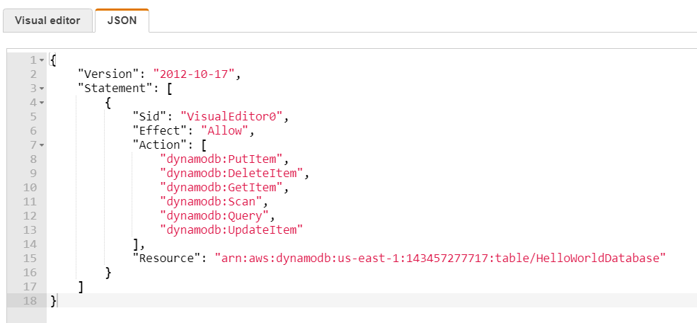
Step by Step process :
Create a dummy Lambda Function ## Function Name: For-API_Integration-DynamoDB
Create an API gateway (REST API) --> Add Method (POST) --> Integrate the Lambda function --> Enable CORS --> stages < Note the URL for future use >
Create a dynamo database ## Table Name: HelloWorldDatabase < Copy the ARN for future use >
Attach an inline policy to the lambda function (For-API_Integration-DynamoDB) IAM role --> for access dynamodb
< use the copied ARN > ​

Slide 4
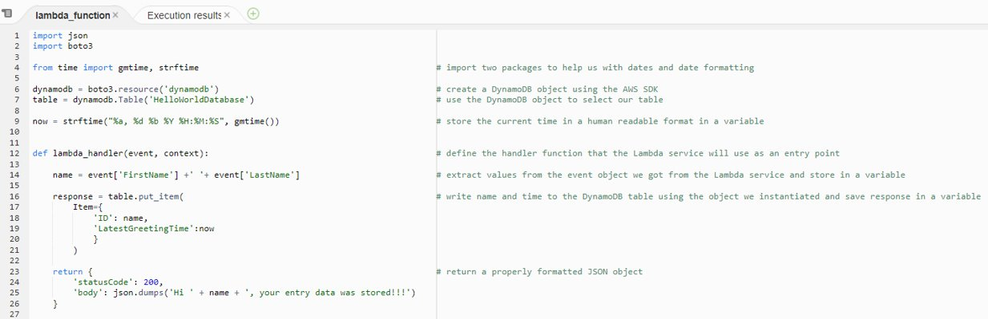
5. In lambda (Function Name: For-API_Integration-DynamoDB): Write a code for put items in database

Slide 5
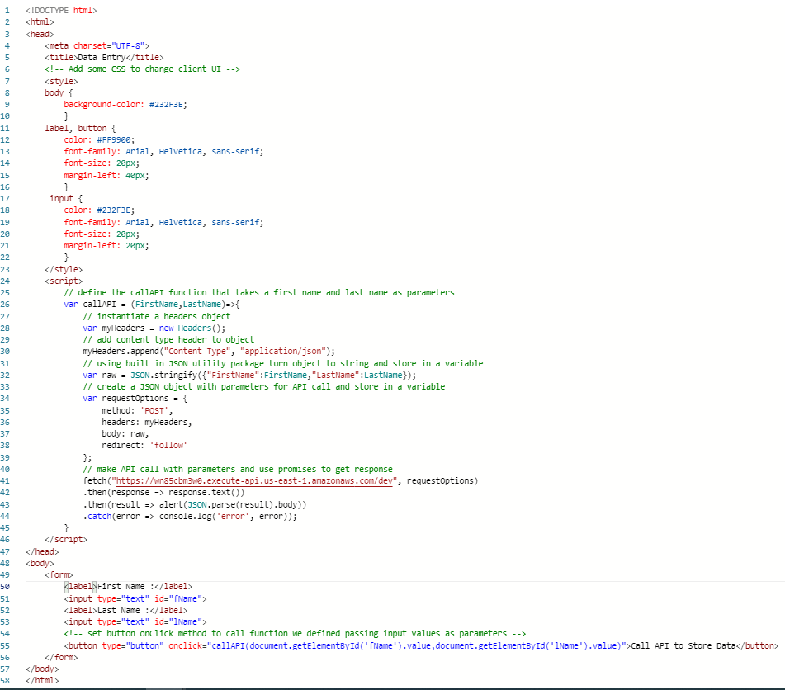
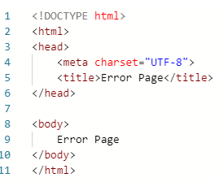
index.html
6. Create an index.html and error.html
< index.html : To fetch the API
using copied URL (in step 2 ) >
7. Create a bucket --> uncheck
block public access --> create
7.1 Upload index.html& error.html file
7.2 Make these file as public
7.3 Enable static website hosting
< Note the URL for Client access >
error.html
Line No : 41 --> API URL

Slide 6
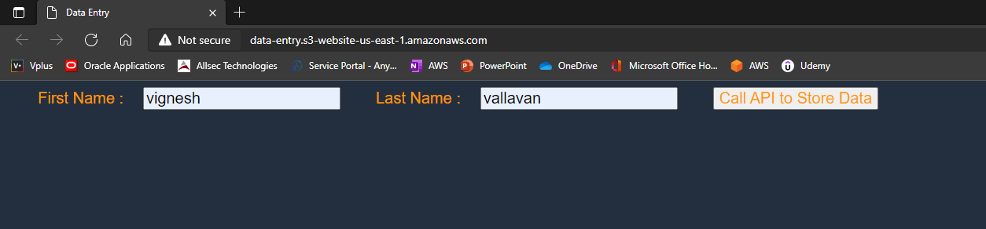
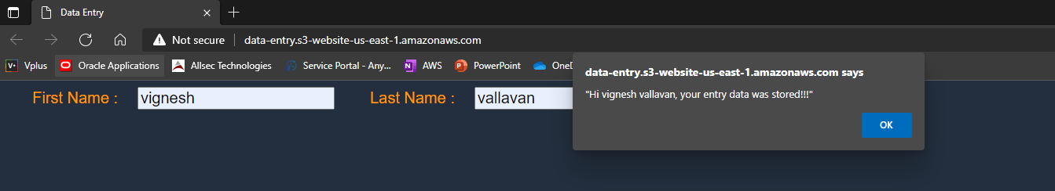
Using S3 (Static website) URL
Client: Enter the data & call API to store it
Response: Once data was collected, Lambda replied with this message

Slide 7
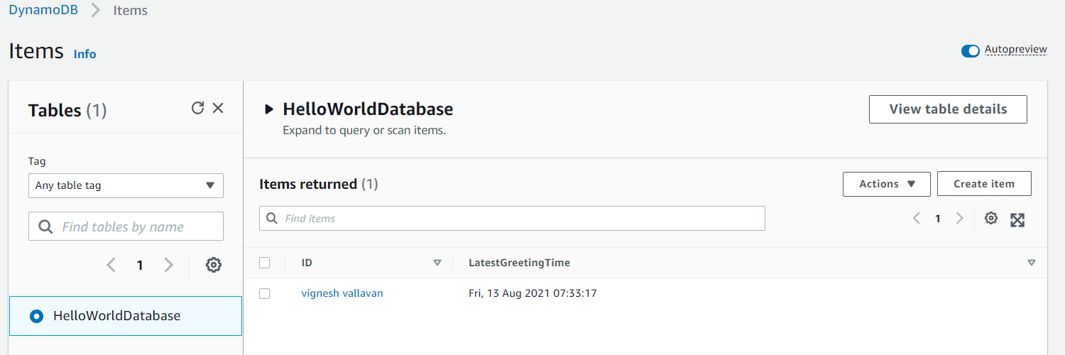
Database: DynamoDB stored the data(FirstName, LastName, Time) into the table

